Slide 1




Case-Control Study Designs
Dr. Zahid Mehmood PT
Assistant Professor/ Researcher
MSPT-NMPT(RIU), DPT(IIRS), Certified Chiropractor

Slide 2

Case-Control Study
In this study design, the researcher starts from ‘‘OUTCOME’’ and goes back to ‘‘CAUSE’’ of a particular disease or injury
Direction is opposite to a Cohort Study

Slide 3
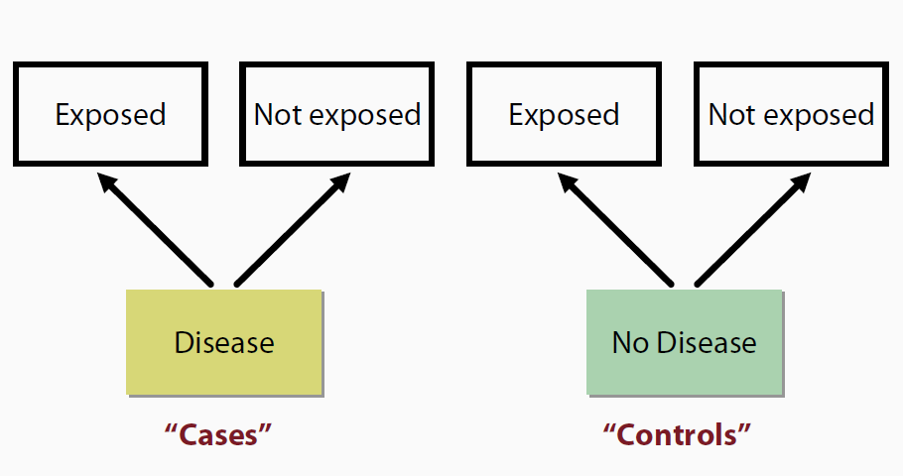
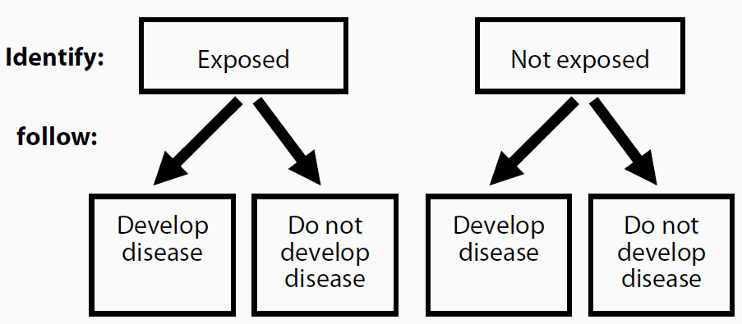
Case-Control Study
Case-control Study Cohort Study

Slide 4
Case-Control Study
In cohort study, we take healthy population at risk of a particular disease
Exclude the person as soon as he/she develops the disease of interest
Called those persons as ‘Cases’
Calculate Incidence Rate in cohort study

Slide 5
Case-Control Studies – Timing
Exposure
Disease
Exposed
Unexposed
?
?
Yes (case)
No (control)
Investigator
Notes:
In a typical case-control study, the investigator begins the investigation after disease has occurred. The investigator enrolls cases (who have the disease), a group of people who do not have the disease (“controls”). The investigator then collects information about prior exposures from the cases and controls. In this way, case-control studies begin with disease and move “backwards” to exposure.

Slide 6
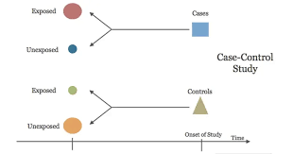
Case-Control Study

Slide 7
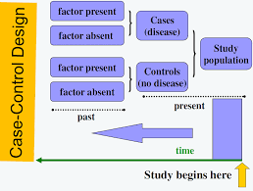
Case-Control Study

Slide 8
Case-Control Study
In case-control study, we take cases and controls
Cases are those who already have developed the disease of interest
Controls are those who are free of disease of interest but are selected from the same population
e.g. golfers developed meniscal injury as ‘Cases’ while those who did not develop meniscal injury are taken as ‘Controls’

Slide 9
Case-Control Study
As disease of interest has already developed among population, we cannot measure ‘Incidence’ in case- control study
In case-control study, we measure ‘Odds’
Odd of exposure in cases and odds of exposure in controls
We take Odds Ratio by comparing two odds

Slide 10
Case-Control Study
An odds ratio (OR) is a measure of association between an exposure and an outcome
The odds ratio obtained from a case–control study tells us how many more (or less) times the cases have been exposed to the factor under study compared with the controls

Slide 11
Case-Control Studies – Steps
Identify cases of disease of concern
Identify appropriate (non-diseased) comparison group
Document exposures among cases and controls
Calculate Odds Ratios (OR)
Perform statistical tests or calculate confidence intervals
Notes:
Here are the steps in conducting a case-control study:
Identify cases of disease of concern
Identify appropriate non-diseased comparison group (“controls”)
Document exposures among cases and controls
Calculate odds ratios
Perform statistical tests or calculate confidence intervals
We will review each step.

Slide 12
Case-Control Study –
Identification of Cases
Identify Cases---people who have developed the ‘disease or outcome’ in question
For example, Golfers who have developed meniscal injury from a nearby hospital

Slide 13
Case-Control Study –
Identification of Controls
Identify Controls---people without ‘disease or outcome’ in question
Controls are selected to estimate the frequency of the exposure in the population
Controls should be taken from the same population as the Cases

Slide 14
Where to Find Controls?
Population-based
Hospital-based
Neighborhood
Friends
Others, such as co-workers, classmates etc
Notes:
Controls can be selected in a number of ways.
Population-based
Hospital- or clinic-based
Neighbors
Friends

Slide 15
Deciding Number of Controls
Increasing controls increases power of the study
Factors to be considered:
  Availability
  Ratio controls / cases
More than one control group?
Notes:
The precision of the study can be improved by increasing the number of study subjects. in a case-control study, the limiting factor is usually the number of available cases. Controls may be easier to find. So we can increase the number of controls. This will increase the power of the study, but not infinitely. Going from one to two controls per case vastly increases the power. Above a ratio of 4 or 5 to 1, the gain becomes very small. It’s usually no use, unless the information is already there, for instance in a computer file.
There is a trade-off between the need for higher study power, and the cost of finding more cases and controls.
The Sample module of EpiInfo’s EpiTable is excellent when you want to calculate the power of your study and decide the ratio of controls to cases. I understand that Denis made also that part of EpiInfo.
Using more than one control group is usually not recommended. It’s costly, and you should be able in advance to decide which is the proper control group.

Slide 16
Case-Control Study
How to obtain data for Case-Control Study:
  Obtain data from previous health status
  New information from patients about their previous health status through Recall
  Association of exposure and disease is measured in terms of Odds Ratio in case-control study

Slide 17
Case-Control Study –
Calculation of Odd Ratio
 |  | Golfers playing long shots
 |  | Exposed | Unexposed
Meniscal Injury among Golfers | Cases | a | b
 | Controls | c | d
Odds of exposure in the cases = a/b
Odds of exposure in the controls = c/d
Odds Ratio = Odds of exposure in cases = a/b = a*d
Odds of exposure in controls c/d b*c

Slide 18
Case-Control Study –
Calculation of Odd Ratio
Odds of exposure in the cases = 56/4 = 14
Odds of exposure in the controls = 30/10 = 3
Odds Ratio = Odds of exposure in cases = 4.7
Odds of exposure in controls
Golfers with meniscal injury are 4.7 times more exposed to long shots as compared to short shots
 |  | Golfers
 |  | Long shots | Short shots
Meniscal Injury among Golfers | Yes | 56 | 4
 | No | 30 | 3

Slide 19
Case-Control Study –
Calculation of Odd Ratio
 |  | Golfers
 |  | Play long shots | Do not play long shots
Golfer’s elbow | Yes | 70 | 12
 | No | 40 | 15
Calculate OR in above example

Slide 20
Case-Control Study –
Advantages
Relatively easy to carryout
Quick and inexpensive
Require comparatively few subjects
Well-suited for rare diseases
No risk to subjects
Allows to study multiple risk factors
After identification of risk factors, rational prevention and control programes could be established
No attrition problem
Few ethical problems

Slide 21
Case-Control Study –
Disadvantages
Usually cannot measure disease risk
Selection, and enrollment of appropriate control group may be difficult (potential selection bias)
Relies on recall or records for info on past exposures (potential recall bias)
May be difficult to determine that ‘cause’ preceded ‘effect’
Not suited to the evaluation of therapy or prophylaxis of disease

Slide 22
Exercises

Slide 23
Unmatched case-control study evaluating maternal folic acid deficiency and congenital defects
Deficiency found in 15 of 100 mothers of cases and 10 of 200 mothers of controls
What is the odds of exposure (folate deficiency) among mothers of cases?
Notes:
23

Slide 24
Smoking and Lung Cancer
 | Cases | Controls
Smokers (<5 / day) | 33 | 55
Non-smokers | 02 | 27
Total | 35 | 82
Calculate OR and Interpret
(P <0.001)
Notes:
24

Slide 25
THANK YOU!!!

