Slide 1
Non-Experimental Study Designs – Cohort Study
Dr. Zahid Mehmood PT
Assistant Professor/ Researcher
MSPT-NMPT(RIU), DPT(IIRS), Certified Chiropractor

Slide 2

What is Study Design?
A study design guides investigator how the investigations will be conducted
Choosing right study design is an important step towards conducting a good research

Slide 3
Types Study Designs
Study Designs
Experimental Non-Experimental

Slide 4
Non-Experimental
Study Designs
Cohort Study
Non-Experimental
Cross-sectional Study
Case-Control Study

Slide 5

Study Designs -
Cohort Study
Cohort is a group of healthy people who are exposed/unexposed to risk factors identified and followed up for certain period of time to ascertain the occurrence of health-related events (disease)

Slide 6
Study Designs -
Cohort Study
A cohort is a group of healthy people, derived from the study population, who share a common experience or condition, and whose outcome is unknown at the beginning of the study

Slide 7
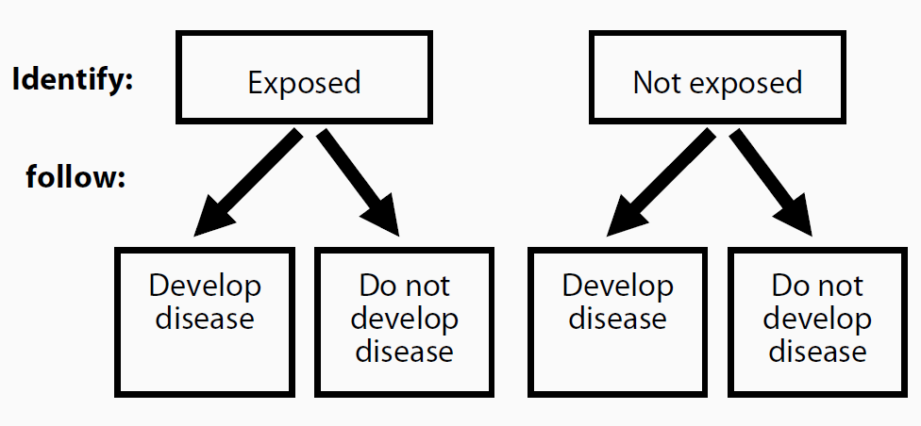
Design of
Cohort Study

Slide 8
Study Designs -
Cohort Study
Fundamental steps in Cohort study
  Identify cohorts of exposed and unexposed individuals who are free of the disease/outcome of interest at the beginning of the study
  Observe each cohort over time for the development of the outcome(s) of interest
  Compare the risks of outcomes between the cohorts

Slide 9
Study Designs -
Cohort Study
An investigator wants whether smoking causes premature failure of a kidney transplant
How will we apply three Fundamental Steps?

Slide 10
Study Designs -
Cohort Study
Fundamental Steps
  Identification of Exposed and Unexposed patients to smoking
  Follow each Cohorts over a period of time
  Compare the risks of Incidence of premature failure of a kidney transplant

Slide 11
Study Designs -
Cohort Study
Patients with Stroke have a high risk of Dementia than those without Stroke
Fundament Steps
  Cohorts of Stroke and without Stroke patients
  Observe cohorts over a period of time
  Comparison of results

Slide 12
Types of Cohort Study -
Cohort Study
Prospective Cohort Study
Retrospective Cohort Study

Slide 13
Types of Cohort Study -
Cohort Study
Prospective: 2014
Begins with a sample
and follows particular
participants into the future

Slide 14
Types of Cohort Study -
Cohort Study
Retrospective: 2000
Asks respondents to recall
their past
  Recall bias
  Incomplete information

Slide 15
Calculations in Cohort
Study
Incidence Rate:
  The number of new cases of a disease / injury of interest occurring in a particular study population over a time period
  Incidence rate = No. of new cases/ total person time

Slide 16
Calculations in Cohort
Study
Relative Risk:
  Measure to compare the risks of developing a particular disease/injury in exposed and unexposed groups
  Relative risk = risk of developing disease among exposed
  risk of developing disease among unexposed

Slide 17
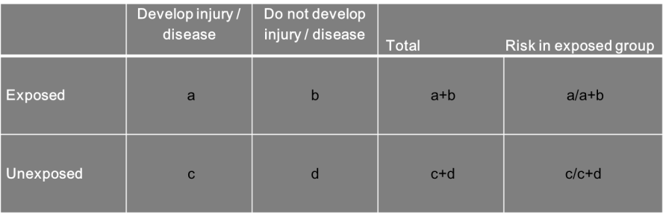
Calculations in Cohort
Study
Risk of developing injury among exposed group= a/a+b
Risk of developing injury among unexposed group= c/c+d
Relative Risk= a/a+b
c/c+d

Slide 18
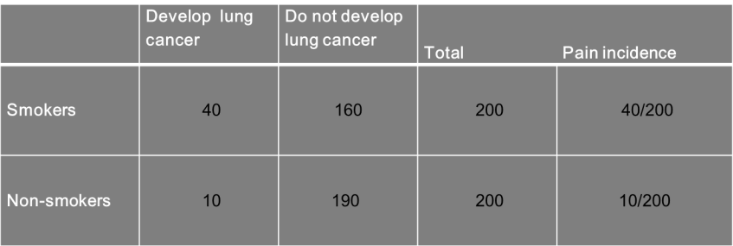
Calculations in Cohort
Study
Risk of kidney transplant failure among smokers= 40/200 = 0.2
Risk of kidney transplant failure among non-smokers= 10/200 = 0.05
Relative Risk (RR)= 0.2/0.05= 4
Risk of kidney transplant failure is 4 times more common among smokers than non-smokers

Slide 19
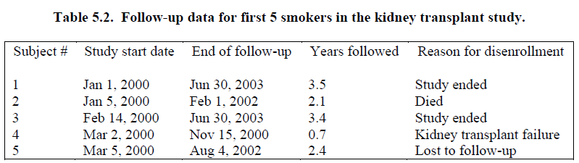
Incidence Proportion of kidney transplant failure
  1 case of failure out of 5---proportion is 20%
Incidence Rate=
  No of new cases/sum of person time
  Here the sum of person time= 3.5+2.1+3.4+0.7+2.4= 12.1
  So, Incidence Rate = 1/12.1*1000
  = 82.6 kidney failure per 1000 person years

Slide 20
Advantages of
Cohort Study
Direct calculation of Incidence rate of a particular event
Temporal relationship btw exposure and outcome

Slide 21
Disadvantages of
Cohort Study
Loss of follow up during long study duration
Heavy financial resources are required
Most efficient for common outcomes than rare

Slide 22
THANK YOU!

