Slide 1

Qualitative vs. Quantitative
Research
Dr. Zahid Mehmood PT
Assistant Professor/ Researcher
MSPT-NMPT(RIU), DPT(IIRS), Certified Chiropractor

Slide 2

Qualitative vs. Quantitative
Research methods and research data can be placed into two basic categories:
Qualitative.
Quantitative

Slide 3
Study Design & it’s Purposes
It is the procedure under which a study is carried out.
Purpose of qualitative study design:
Produces more in-depth, comprehensive information & description
Uses subjective information and participant observation
It seeks a wide understanding of the entire situation.
Purposes of a quantitative study design:
To describe current situations
To investigate relationships between variables
To study causes and their effects

Slide 4
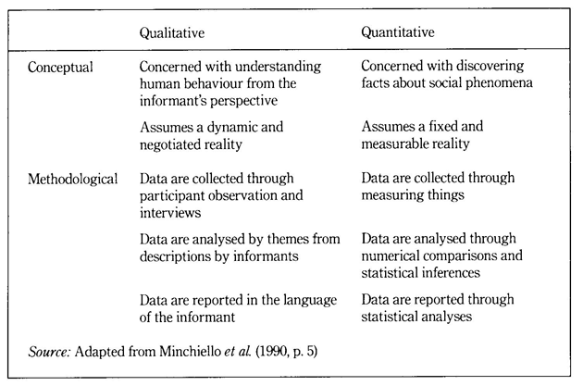

Slide 5
Qualitative Research

Slide 6
Qualitative Research
Qualitative research gathers information that is not in numerical form.
For example, open-ended, unstructured interviews and unstructured observations.
Qualitative data is typically descriptive data and as such is harder to analyze than quantitative data.
Qualitative research is useful for studies at the individual level, and to find out, in depth, the ways in which people think or feel (e.g. case studies).

Slide 7
Qualitative Research
Analysis of qualitative data is difficult and requires an accurate description of participant responses
Expert knowledge of an area is necessary to try to interpret qualitative data and great care must be taken when doing so, for example, if looking for symptoms of mental illness.

Slide 8
Qualitative Research
A good example of a qualitative research method would be unstructured and group interviews which generate qualitative data through the use of open questions.
This allows the respondent to talk in some depth, choosing their own words.
This helps the researcher develop a real sense of a person’s understanding of a situation. However, it can be time consuming to conduct the unstructured interview and analyse the qualitative data.

Slide 9
Qualitative Research
Case Study:
Description: In-depth analysis of a single entity in its real-life context.
Use: To deeply understand complex issues in specific cases.
Ethnography:
Description: Detailed study of cultures through participant observation.
Use: To explore cultural practices and social interactions.
Phenomenology:
Description: Investigation of lived experiences to understand their essence.
Use: To explore subjective perceptions and experiences.
Grounded Theory:
Description: Developing theories based on data from participants.
Use: To generate new theoretical insights.

Slide 10
Qualitative Research
Narrative Research:
  Description: Study of personal stories to understand experiences.
  Use: To explore individual life stories.
Action Research:
  Description: Collaborative problem-solving through cycles of action and reflection.
  Use: To improve practices and resolve issues.
Content Analysis:
  Description: Systematic coding and interpretation of textual or visual content.
  Use: To identify patterns and themes in media or documents.
Discourse Analysis:
  Description: Examination of language use to understand social constructs.
  Use: To analyze the role of language in social contexts.

Slide 11
Quantitative Research

Slide 12
Quantitative Research
Quantitative research gathers data in numerical form which can be put into categories, or in rank order, or measured in units of measurement.
This type of data can be used to construct graphs and tables of raw data.

Slide 13
Quantitative Research
Experiments typically yield quantitative data, as they are concerned with measuring things.
However, other research methods, such as observations and questionnaires can produce both quantitative and qualitative information.

Slide 14
Quantitative Research
For example, a rating scale or closed questions on a questionnaire would generate quantitative data as these produce either numerical data or data that can be put into categories (e.g. “yes”, “no” answers).
Whereas open-ended questions would generate qualitative information as they are a descriptive response.

Slide 15
Quantitative Research
Experimental methods limit the possible ways in which a research participant can react to and express appropriate social behavior.
Findings are therefore likely to be context-bound and simply a reflection of the assumptions which the researcher brings to the investigation.

Slide 16
Quantitative Research
Descriptive Designs:
Survey Research
Case Series
Case Report
Registry Summaries
Analytical Designs:
Observational
Experimental

Slide 17
Quantitative Research
Observational Designs:
Case Control
Cohort Study
Cross-sectional (Epidemiology)
Experimental Designs:
Randomized Control Trial
Non-Randomized Control Trial (Qusai Experiments)

Slide 18
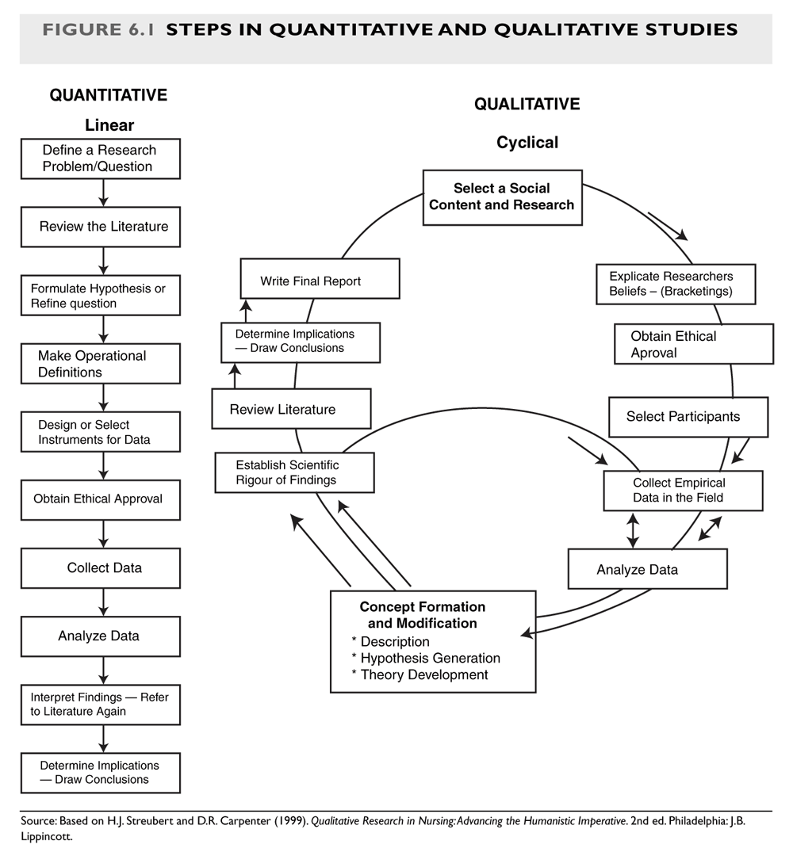
Qualitative Paradigm

Slide 19
THANK YOU!!!

