Slide 1
SYNOPSIS WRITING

Slide 2
Why Research?
For extrinsic factors
Evidence based medicine/dentistry
Support an evidence
Find the truth!!
For policy making and informed decision making
Notes:
(i.e. professional growth/ promotions/ fulfil requirements etc.)

Slide 3
What is Research?
Research is a systematic process of collection and analysis of data and later on its interpretation so as to find solutions to a problem or any event around us.

Slide 4
Steps to conduct Research
Research is a systemic process starting from selection of research topic and ends at reporting the research findings at local/international journals or scientific meeting.

Slide 5

Steps for Conducting Research

Slide 6
Step 1: Selecting a Research topic and formulating objective/s
To assess what questions will the study address.
What will it measure?

Slide 7
Step 2: Undertaking literature review
To establish why the question is important?
What is already known about it?
What new will this study assess?

Slide 8
Step 3: Selecting a study design
To ensure that the research design matches the objectives set.

Slide 9
Step 4: Selecting the Research subjects/site
To ensure generalizibility and validity.
Recruit adequate number of participants to have confidence in your findings.

Slide 10
Step 5: Identify the study variables
To be clear in context to
Predictor (Independent variables) variables
Outcome (Dependent variables) variables

Slide 11
Step 6: Formulate the questionnaire and collect data
Collection of data should be aligned to the objective/s
The data collection form (study tool should be valid).
Data on all relevant variables (both independent and dependent variables) are collected.

Slide 12
Step 7: Analyzing data
Analyze quantifiable data.

Slide 13
Step 8: Report the findings
Report the findings of the study in
Scientific journals
Poster exhibition
Conference presentations

Slide 14
Why Research Proposal
Learning Outcomes
Why develop a Research Proposal

Slide 15
Research Proposal/Synopsis Writing
Research Proposal/Synopsis and Research Protocol are synonymous terms.
First step taken prior to initiation of any research project.

Slide 16
Research Proposal describes
It is a research plan with well-defined measurable outcome that an investigator aims to follow to achieve the research objectives.
It precisely describes the
importance of the area of research
the research questions/hypothesis behind the research
how it will be carried out.

Slide 17
Subtopic : Selection of Research Topic
Learning Outcomes:
How to decide on a research topic

Slide 18
Selection of a Research Topic
Remember the FINER criteria for selecting a Research topic
Feasible
Interest
Novel
Ethical Consideration
Relevance

Slide 19
Feasibility
It means the availability of different resources that you may need to carry out the research project.
It includes manpower, money, material, machinery, skills and time etc.

Slide 20
Interest
Have you got an Interest for the Topic of Research??

Slide 21
Novel
It is good to look into a new problem but it is not always possible to work for new problems as you may have limited resources.
Thus, you can work on the old problem but with a different perspective.

Slide 22
Ethical Consideration
It includes
Informed consent
Non-maleficence (do no harm)
Confidentiality

Slide 23
Relevance
Here consider the prevalence of the problem in which you are interested.
In other words, how big is the problem.

Slide 24
Subtopic : Resources for Literature Search
Learning Outcome:
What are the freely available resources (Repository) to search articles
How to search relevant articles and scientific material

Slide 25
Resources Of Literature Search
Relevant scientific literature could be searched through internet, medical journals (electronic or paper based), conference literature etc.
Spend adequate time in conducting literature search

Slide 26
Freely Available Resources
The freely available resources are
Biomed Central
Pub Med (http://www.ncbi.nlm.nih.gov/PubMed/)
BMJ
Google scholar (help to locate articles)
Cochrane
Scopus

Slide 27
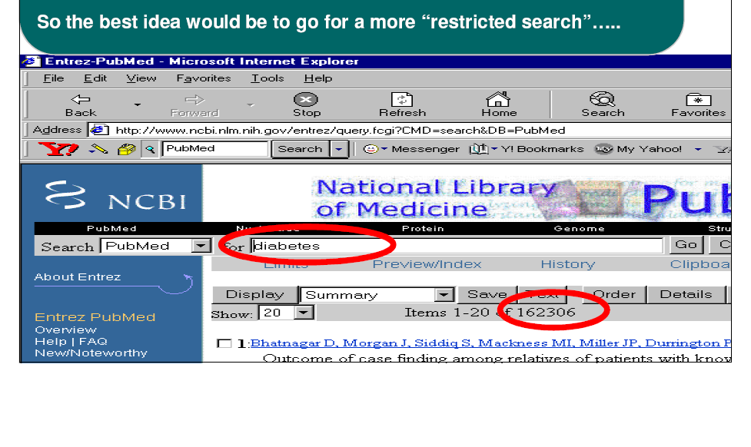
Search Through Keywords (Diabetes)

Slide 28
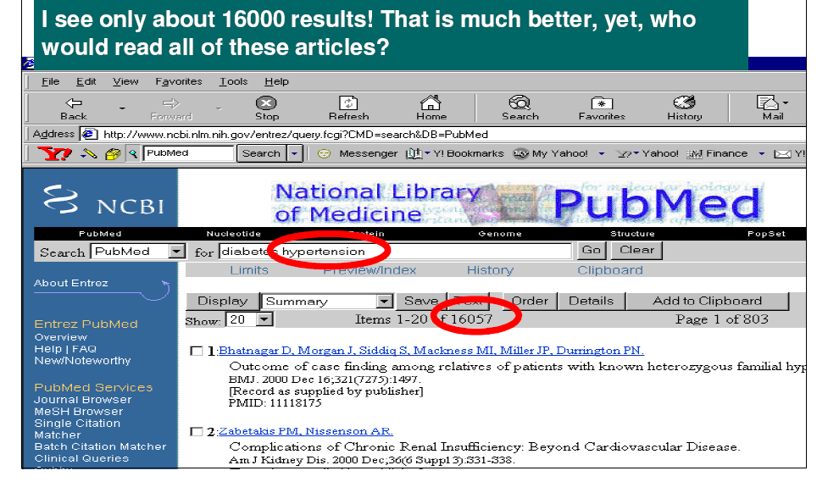
Keywords (Diabetes, Hypertension)

Slide 29
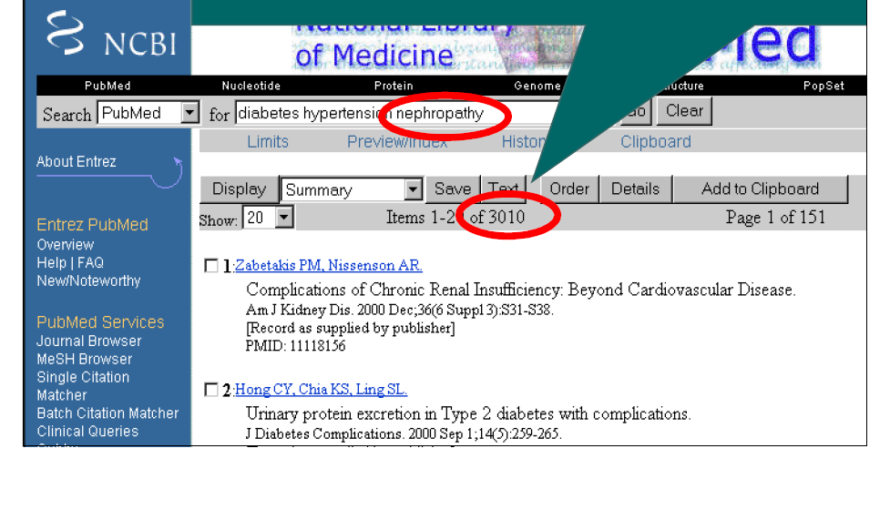
Keywords (Diabetes, Hypertension, Nephropathy)

Slide 30
Title of the Research Project
Learning outcome
What title should be given to the study

Slide 31
Study Title
The title precisely reflects the objective (s) of the proposed study concisely and clearly.
Must provide the "keywords" for classification and indexing of the research project.
Notes:
Include the keywords in the title, as it helps the reader to identify whether the article is of relevance to him/her or not as well as help the reader to locate articles of interest.

Slide 32
For Clinical trial Study
If your study is a clinical trial being carried out on children with ear infections using an antibiotic X, then your key features should be reflected in the title.
"Role of antibiotic X in children with ear infections - a clinical trial."
Another Example
“Adoption of a tooth brushing technique: a
randomised controlled clinical trial”

Slide 33
For Cross-sectional Survey
Prevalence of developmental defects of enamel in children and adolescents with Asthma: A cross sectional survey.
Knowledge, Attitudes, and Practice Regarding Infection Control Measures Among Dental Students in Central India
Perceived source of stress among final year dental undergraduate students in a dental teaching institution at Banglore, India: A cross-sectional survey.

Slide 34
For Case Control Study
If you want to evaluate the association between Maternal Periodontitis and Preterm delivery or Low Birth Weight.
Your Title should say
The relationship between maternal Periodontitis and preterm low birth weight: A case-control study

Slide 35
Writing an Introduction

Slide 36
Introduction
Most important part of the research protocol.
Convince reviewer that the research is going to be different from what other people have done.
Gives statistical facts about the burden of problem under study (how big the problem is), cost of illness.
Remember: Narrow down the statistical facts.

Slide 37
Introduction Continued..
An introduction should ideally comprise of four paragraphs:
Addressing what is known about the problem
What is not known about the problem
Point out the existing gaps in scientific knowledge
How the study will contribute to fill the gap and strength of the study planned.

Slide 38
Research Objective

Slide 39
Research Objective
A research objective is a statement that clearly reflects the goal to be achieved by a research project.
The objectives of a research project summarize what a study plans to achieve.
Must match the hypothesis and data analysis plan.
An objective should be stated in clear, measurable terms.
Researcher can have as many objectives as he feels that the study is feasible to achieve.

Slide 40
Research Objective Continued…
The formulation of objectives will help you to
Focus the study (narrowing it down to essentials)
Avoid the collection of unnecessary data
Organize the study in clearly defined parts or phases.

Slide 41
Research Objective Continued…
Objectives should be stated using “action verbs” that are specific enough to be measured:
Examples:
To determine …, To compare…, To evaluate…, To calculate… etc.
Do not use vague non-action verbs such as:
To appreciate … To understand… To believe

Slide 42
Research Objective Continued…
Example 1
To determine their level of knowledge, attitudes, and practice regarding infection control measures and if any correlation exists among the knowledge, attitudes, and practice scores.
Example 2
To evaluate the association between Maternal Periodontitis and Preterm delivery or Low Birth Weight.

Slide 43
Material and Methods

Slide 44
Methodology
The methodology explains the procedures that will be used to achieve the objectives.
The methodology of a research project is the CORE OF THE STUDY.

Slide 45
Components of a Methodology Section
Components of a research Protocol in the methodology section
Operational definition
Variables
Research design
Sampling method
Sample Size
Data collection plan/procedure
Ethical considerations
Data analysis plan
Budget/Logistics
References

Slide 46
Operational Definition
It is the definition of the exposure and outcome variables of interest in context to objective in a particular study and their means of measurement/determination.

Slide 47
EXAMPLE 1
Consider that one wishes to do a study on anemia in patients with chronic kidney disease (CKD). He has to give an operational definition of anemia in his study. This definition of anemia should not be a textbook definition of anemia, rather it should mention what anemia means in this particular study.
For example, he should mention an operational definition that anemia in this study is defined as haemoglobin less than 11 gm/dl. This cut-off of 11 gm/dl should ideally come from a world recognized body like the WHO or National Kidney Foundation.

Slide 48
EXAMPLE 2
A study to compare the effectiveness of dressing A and dressing B in patients presenting with infected wounds of the foot. An outcome variable should be easily measureable. By looking at the objective it is not clear that what will be deemed as effective and how will effectiveness be measure.
So effectiveness should be defined in clear measurable terms. “The effectiveness could be defined as positive if there is presence of granulation tissue on clinical examination on the 7th postoperative day”.

Slide 49
VARIABLE
A variable is a measureable characteristic of a person, object or phenomenon that can take on different values.
A simple example of a variable is a person’s age. The variable age can take on different values because a person can be 20 years old, 35 years old, and so on.

Slide 50
DEPENDENT VARIABLE
The variable that is used to describe or measure the problem under study is called the dependent variable.
A dependent variable is also known as a "response variable", "outcome variable", and "output variable".

Slide 51
INDEPENDENT VARIABLE
The variables that are used to describe or explain the difference in the dependent variable are called the independent (exposure) variables.
An independent variable is also known as a "predictor variable", "explanatory variable", and "exposure variable".

Slide 52
Study Design
The selection of an appropriate study design is essential for any study.
The study design should match the specific objectives of the study.
Inappropriate study design will yield non-valid and non-reliable results.

Slide 53
Study Design Continued…
The type of study design chosen depends on the
Type of problem/objective under investigation
Knowledge already available about the problem
Resources available for the study

Slide 54
Classification of Study Design
Descriptive (describes the distribution of the disease)
  Case-Reports/Case Series
  Cross-Sectional Studies
Analytic Studies (uncovers the causes)
  Case-Control Studies
  Cohort Studies
    Prospective
    Retrospective
  Experimental (Interventional) Studies
  Controlled Trials
    Randomized (RCCT)
Observational studies

Slide 55
Observational Studies
Observational research is type of non-experimental research in which a researcher observes ongoing behaviour (naturalistic observation).
In observational studies participants are
Not Randomised
Not Intervened

Slide 56
Classification of Study Design
Descriptive Studies – the researcher quantifies the distribution of certain variables (in %) in a study population at one point of time. It has one group only.
Analytical Studies – attempts to establish causes or risk factors for certain problems. This is done by comparing two or more groups, some of which have or develop the problem, and some of which do not have.

Slide 57
Types of Research Design
Observational Designs for Generating Hypotheses
  Cross-Sectional Studies
  Case Report/Case Series
Observational Designs for Generating / Testing Hypotheses
  Cohort Studies
  Case-Control Studies
Experimental Designs for Testing Hypotheses
  Randomized Controlled Clinical Trials (Gold Standard)

Slide 58
Descriptive Observational Studies
Case Report
Case Series
Cross-sectional studies

Slide 59
Descriptive Observational Studies
Carried out in one patient group
No hypothesis at the beginning of the study
A hypothesis can be generated based over the conclusion of such studies

Slide 60
Case Report
A detailed report by a physician of an unusual disease in a single person
Classical example is that of a single case report in Germany in late 1959 of a congenital malformation affecting the limbs and digits
More cases were reported in the following year. In 1961 a hypothesis was put forward that thalidomide, a commonly prescribed drug for nausea and vomiting was responsible.
Notes:
Just like a good history that includes presenting features, clinical signs, lab investigations and diagnosis after excluding differential diagnosis.

Slide 61
Case Series
When several unusual cases all with similar conditions are described in a published report, this is called a Case Series
Subsequently after the first case report of thalidomide tragedy a case series was published in 1961.
Thus it was hypothesized that exposure (Thalidomide) will lead to outcome (mal developed child).

Slide 62
Cross-sectional Studies
A cross-sectional study is a survey of a population at a single point in time e.g. an interview survey and a mass screening program
Also called “Prevalence Studies”
Determines the “burden of disease” in a population
The data is collected at one point of time.
The hallmark of such studies is that there is no follow-up.

Slide 63
Example
National Health Survey of Pakistan on the prevalence of Dental Carries in Pakistan
Pakistan National Diabetic Survey – prevalence of DM in Pakistan

Slide 64
Analysis of Cross-sectional Studies
The main outcome measure obtained from a cross-sectional study is prevalence.
Prevalence=
Number of cases in a defined population at one point of time
Number of persons in a same population at same point in time

Slide 65
Limitations of Cross-sectional Studies
Not suitable to study the association between an exposure and an outcome
It is difficult for the researcher to establish whether the exposure preceded the outcome or not
Thus hard to establish a Temporal Association

Slide 66
Example
If the researcher is studying the association of uric acid level and hypertension, and on analysis finds that most of the hypertensive patients have hyperuricaemia as well.
Here the researcher cannot say with confidence that hyperuricemia is really an exposure/risk factor for hypertension (outcome); as hyperuricaemia can cause hypertension and hypertension is also a risk factor for hyperuricaemia.

Slide 67
Cross-sectional Studies- Advantages
Fairly quick and easy to perform
Inexpensive
Useful for determining the prevalence of risk factors
Useful for measuring current health status and planning for some health services

Slide 68
Cross-sectional Studies- Disadvantages
Provide only a “snapshot” in time which may result in misleading information if the research question is one that follows a group of patients over a period of time process e.g. normal aging and diastolic blood pressure
The data about both the exposure to risk factors and the presence or absence of disease are collected simultaneously, hence it is difficult to determine temporal relationship of a presumed cause and effect
Non-Responders - in surveys, it is difficult to obtain sufficiently large response rates, as some people are too busy or reluctant to participate

Slide 69
Sampling Method
Sampling involves the selection of a finite number of elements from a given population of interest, for purposes of inquiry.
A researcher can use either a probability or non-probability sampling technique after considering the cost, resources available and practicability.

Slide 70
Sampling Method (Continued..)
Probability sampling techniques are preferred by researchers as maximizes external validity or generalizibility of the results of the study.
Non-probability sampling techniques introduces selection bias in the research.

Slide 71
Key Terms
Population is the term statisticians use to describe a collection of items that have something in common.
Target population is a group about which researcher aims to draw conclusion.
A “sample” is a subset of population with all its inherent qualities

Slide 72
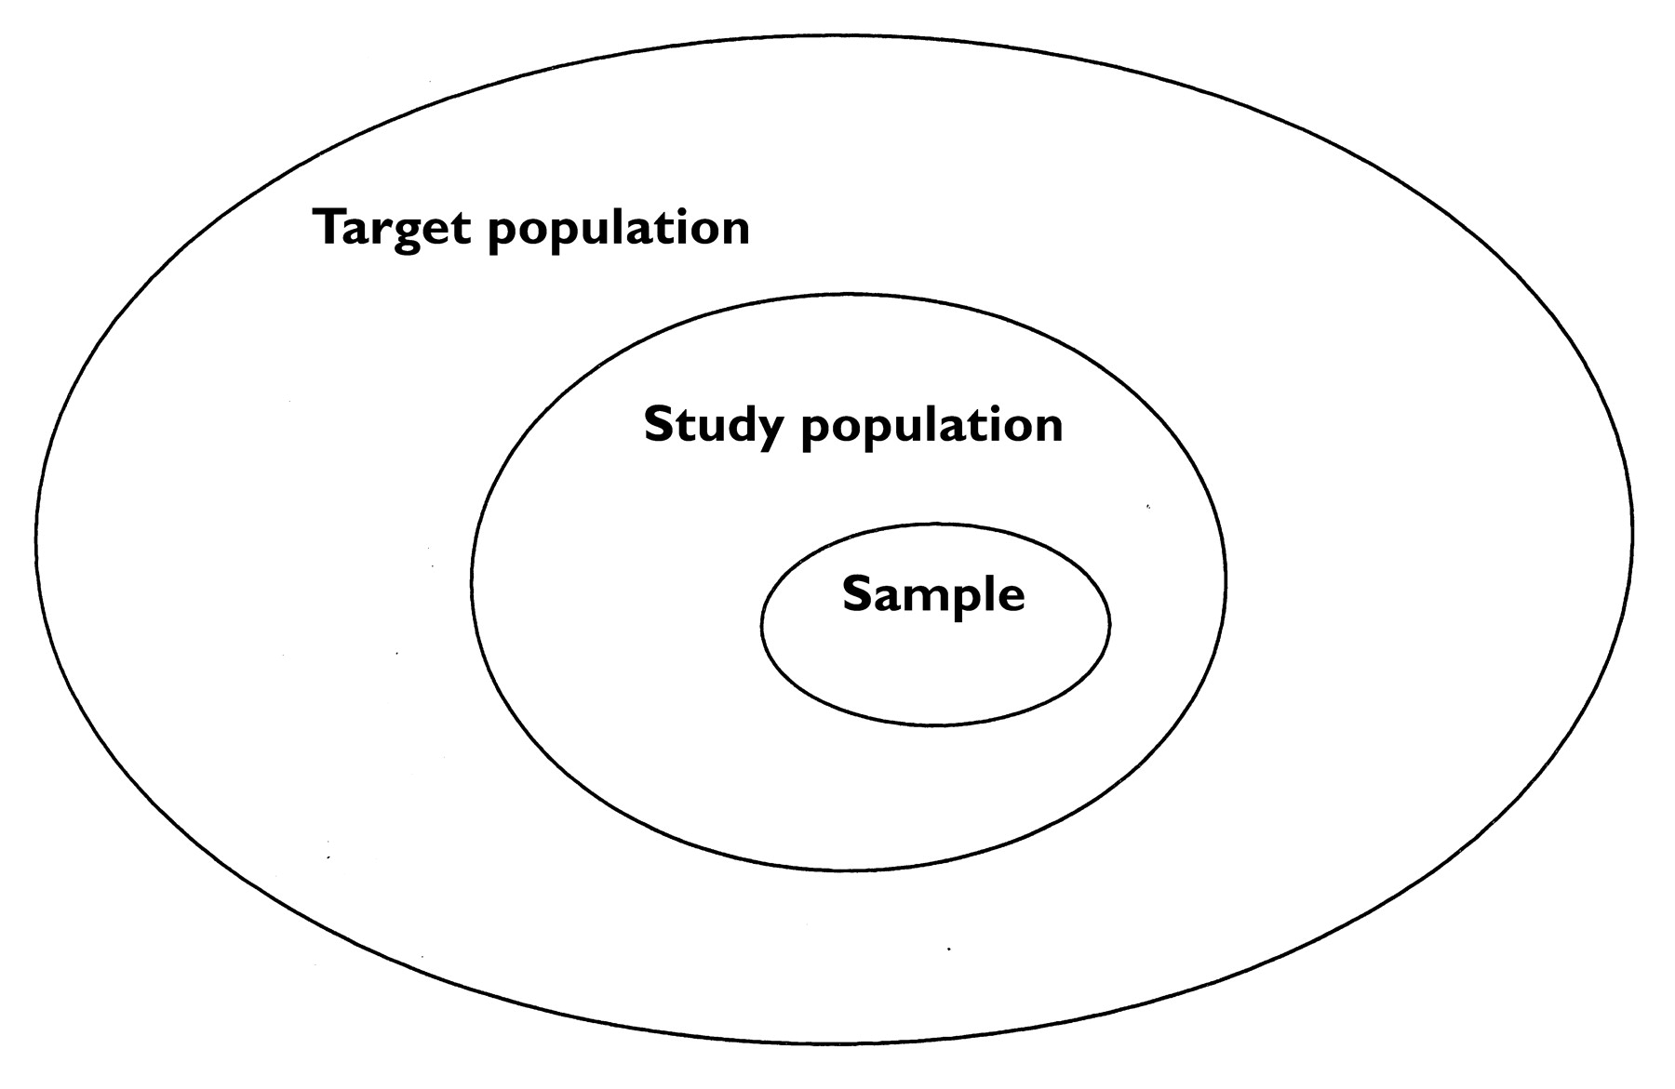
Relationship among Sample, Study population and Target population

Slide 73
Reasons for Sampling
It is reasonable and practical to collect information from sample rather than the whole population.
Below are the reasons listed for sampling
Samples can be studied more quickly than population
A study of a sample is less expensive than that of an entire population
A study of a population is impossible in most situations

Slide 74
Sampling Technique
Broadly, there are two types of sampling techniques
Probability sampling techniques
Non-Probability sampling techniques

Slide 75
Sampling Technique
In a probability sampling technique, each participant in a study population has an equal (or at least a known) chance of being selected.
In a non-probability technique each participant does not have an equal chance of being selected.

Slide 76
Different Sampling Technique
Probability Sampling Technique | Non-Probability Sampling Technique
Simple Random Sampling | Consecutive Sampling
Systemic Random Sampling | Convenience Sampling
Stratified Random Sampling | Snowball Sampling
Cluster Random Sampling | Purposive (Judgemental) Sampling

Slide 77
Simple Random Sampling
Simple random sampling is the simplest method of probability sampling.
In this type of sampling technique each individual within the study frame has an equal chance of inclusion in the sample.
Examples:
Lottery method
Computer generated list

Slide 78
Systemic Random Sampling
In systemic sampling technique study participants are selected at regular intervals using a sampling frame.
Just estimate the population size (N) and calculate the required sample size (n).
Now divide population size by sample size, i.e., N/n.
This will give you the k- th number (sampling interval).
First element is selected randomly from 1st to k^{th} element.
Then every k-th element is selected till the researcher achieves the required sample size.

Slide 79
Stratified Random Sampling
Stratified random sampling is a sampling technique that divides the population into various sub-groups i.e. based on gender, age groups, ethnicity etc.
Suppose a population consisted of more females than males.
In spite of the random technique employed, females will constitute a greater proportion of sample than males.
Such problem could be overcome by utilizing stratified random sampling.

Slide 80
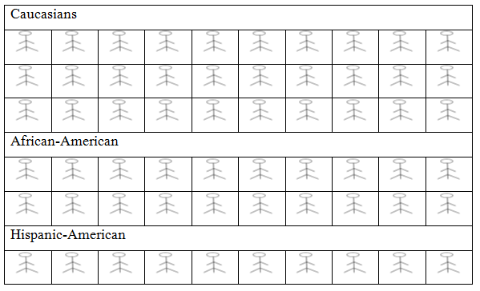
Stratified Random sampling technique (individual in each strata)

Slide 81
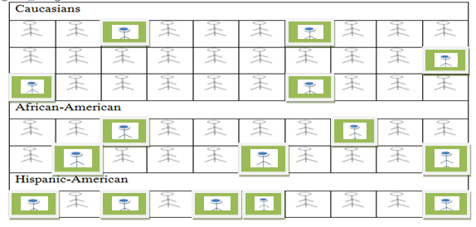
Stratified random sampling technique (Participants selected from each strata represented by bold-headed stickman).

Slide 82
Cluster Sampling
In clustered sampling technique sub-group of population is used as a sampling unit instead of individuals.
Suppose the city of Karachi consisted of 18 towns and each town consisted of 10 union councils.
Initially, 5 towns are selected by either of the random technique methods.
Later, from each town 4 union councils are randomly selected. Finally, from 20 union councils houses are randomly selected.

Slide 83
Non-Probability Sampling Technique
Consecutive Sampling
Convenience Sampling
Snow Ball sampling
Purposive (Judgemental) Sampling

Slide 84
Consecutive Sampling
Sequential selection of all accessible eligible participants that meets the selection criteria.
Suppose, a strategy is devised to recruit 100 patients (the estimated sample size) for a study that satisfies the selection criteria and seen in a Nephrology clinic from Monday to Friday between 9.00 am to 12.00 pm.
The first 100 patients who meets the eligibility criteria and attend the outpatient clinic during these days and timings will be recruited in the study.

Slide 85
Convenience Sampling
Convenience sampling is presumed to be the most commonly used technique in clinical research.
It involves the selection of subjects that are conveniently accessible to the researcher.

Slide 86
Snow Ball sampling
Snow Ball sampling method is employed when study participants are difficult to identify, access or locate.
The method is commonly employed to recruit participants from hard to reach group (i.e. sex workers, IV drug users etc.).
The sample is built through chain referrals.

Slide 87
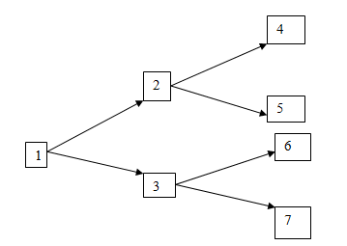
Snow Ball sampling

Slide 88
Purposive (judgemental) Sampling
The researcher selects study participants with a 'particular purpose' in mind.
Based over pre-existing belief that certain subjects will be more likely benefit or respond in certain way.
Introduce Selection Bias in the research.
Example:
Relatives of HIV patients

Slide 89
STUDY POPULATION

Slide 90
Inclusion and Exclusion Criteria
It is important for a researcher to have a pre-defined inclusion and exclusion criteria regarding what participants will be included in the study.
Inclusion of subjects that should not be included, or excluding participants that should have been included would make the findings less valid.

Slide 91
Example
A study was planned to evaluate the efficacy of parenteral iron. As the parenteral iron has a teratogenic effect on pregnant women in first and second trimester, thus all pregnant women in first and second trimesters were excluded. Moreover, parenteral iron is indicated when the HB level falls below 8 gm/dl, thus only those pregnant women in third trimester whose Hb level were below 7 gm/dl were included.

Slide 92
Word of Caution (Do not Replicate!!)
It’s a word of caution for junior researchers who often tend to write a few inclusion criteria and then write the opposite in the exclusion criteria.
For example, in a study about adult population they would write as all participants who are aged 18 and above will be included.
In the exclusion criteria, they would write " children will be excluded."
This is bad practice and must be avoided

Slide 93
Duration of study
It is also important to make clear that during what time period the data will be collected.
For example
“All participants who attend the outpatient diabetic clinics of XYZ hospital from 1st January 2012 to 31st December 2013 will be included in the study."

Slide 94
Proposed Intervention (If Applicable)
Give details of interventions (i.e. educational program, vaccine, treatment etc.)
Generally applicable for Comparative studies with Experimental design.
Answer these fundamental questions.
Who will be responsible for giving the intervention?
Where will it take place?
What activities will be performed, and with what frequency and intensity?

Slide 95
Sample size estimation
Learning Outcome:
Participants should be able to calculate sample size required for different study types by using sample size software.
Participants should develop skills how to write sample size estimation in Research Proposal.

Slide 96
Sample Size
The sample size calculation depends on:
Type of study
Magnitude of the outcome of interest derived from previous studies
Type of statistical analysis required (comparing means or proportions)
Level of significance / Power

Slide 97
Software to be used for Sample size calculation
Sample size software that are more commonly used and are user friendly are
WHO sample size calculator
Open epi
Epitools
(http://epitools.ausvet.com.au/content.php?page=SampleSize)

Slide 98
SAMPLE SIZE FOR SINGLE PROPORTION
Sample size calculation for single proportion depends on
The prevalence of the condition/attribute of interest
Level of confidence
Margin of error

Slide 99
Example
A researcher aims to estimate the prevalence of Chronic Kidney Disease (CKD) among adults greater than 18 year of age in a locality. How many adults should be included in the sample if the Reference Study has reported 40% prevalence?

Slide 100
Input Values in Sample size calculator
Values needed to be entered into the sample size calculator
Confidence interval: 95%
Anticipated prevalence or population proportion for CKD: 40%
Absolute precision required : 5%

Slide 101
Sample Size Calculated
The estimated sample size calculated is 369.
Thus, at least 369 participants must be recruited in the study to determine the prevalence of CKD at confidence interval of 95%, with a precision of 5%.

Slide 102
SAMPLE SIZE FOR SINGLE GROUP MEAN
Sample size for single group mean depends on
The mean of the condition of interest
Level of confidence
Margin of error

Slide 103
Example
A researcher aims to estimate the mean hemoglobin level among pregnant women admitted to a tertiary care hospital. A previous study of pregnant women showed average hemoglobin level 8.2 g/dl and standard deviation of 4.2 g/dl. How many pregnant women must be studied if he wants the estimate should fall within 1 g/dl with 95% confidence?

Slide 104
Input values in WHO sample size software
Values needed to be entered into the WHO sample size calculator are
Confidence interval: 95%
Population mean (Average haemoglobin of pregnant women identified from previous study: 8.2g/dl
Population standard deviation: 4.2 g/dl
Absolute precision required: 1g/dl

Slide 105
Sample Size Calculated
The estimated sample size calculated is 68.
Thus, at least 68 participants must be recruited in the study to estimate the mean hemoglobin level among pregnant women at confidence interval of 95%, with a precision of 1 g/dl.

Slide 106
SAMPLE SIZE FOR TWO PROPORTIONS
Sample size for two proportion depends on
The prevalence of the condition / attribute of interest for both groups
Level of confidence
Power of the test

Slide 107
Example
It is believed that the proportion of patients who develop depression on one type of dialysis modality (peritoneal dialysis) is 5% while the proportion of the patients who develop depression on other type of dialysis modality (hemodialysis) is 15%. How large should be the sample size in each of the two groups of patients if an investigator wishes to detect with a power of 80%, whether the second dialysis modality (hemodialysis) has depression rate significantly higher than the first at 5% level of significance?

Slide 108
Input values in sample size calculator
Values needed to be entered into the WHO sample size calculator
Confidence interval: 95%
Anticipated prevalence of depression in peritoneal dialysis patients: 5%
Anticipated prevalence of depression in hemodialysis patients: 15%
Power of test: 80%

Slide 109
Sample Size Calculated
The estimated sample size calculated is 320.
Thus, at least 160 participants must be recruited in each group to estimate any significant difference in depression in two different types of dialysis modality at a power of 90%.

Slide 110
Sample size for Two Group Mean
Sample size for two group mean depends on
The means and variance of both groups
Level of confidence
Power of the test

Slide 111
Example
Suppose the true mean systolic blood pressure (SBP) of 35 to 39 year old oral contraceptive (OC) users is (135 mmHg) and standard deviation (16 mmHg). Similarly, for non-OC users, the mean SBP is (130 mmHg) with standard deviation (17 mmHg). If we desire to estimate the difference between 2 groups of equal size, what would be the minimal sample size required with a power of 80% at 95% confidence level?

Slide 112
Input values in the Open Epi Software
Values to be entered into the Openepi software
Confidence interval: 95%
Power: 80%
Mean Systolic BP of Oral Contraceptive users: 135 mmHg
Standard deviation of Oral Contraceptives users: 16 mmHg
Mean Systolic BP of non Oral Contraceptive users:130 mmHg
Standard deviation of non Oral Contraceptive users: 17 mmHg

Slide 113
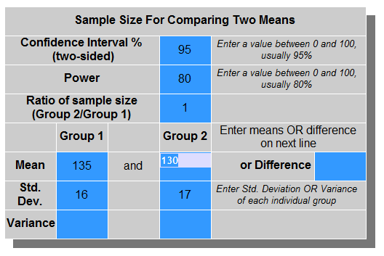
Sample size calculated by Epi info software

Slide 114
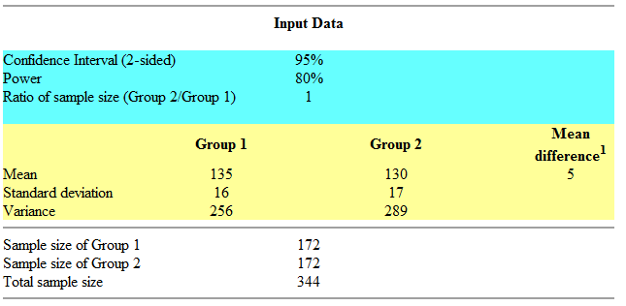
Sample size calculation results

Slide 115
Sample Size Calculated
The minimum sample size require to compare the mean of OC and non-OC user is 344.
Thus 344 (172 in each group), participants must be recruited in the study to estimate the difference in two groups at 95% confidence interval with a power of 80%.

Slide 116
DATA COLLECTION

Slide 117
Data Collection
Data collection is the most important part of any research.
Data collection techniques allow us to systematically collect information about our objectives of study .
Initially, the researcher must make it clear whether a Primary Data will be collected or a Secondary Data will be used for the research.

Slide 118
Primary Data
Primary data is a first hand information through a data collection form or a performa.

Slide 119
Primary Data (Continued…..)
In the data collection portion of the research protocol include demographic, socio-economic status, lab variables and outcome variable etc.
The demographic variables include; age, gender, race, ethnicity, marital status, etc.
Moreover, the researcher should also make clear as to what is his outcome variable/ variables (e.g. mortality, hospitalization. length of stay, quality of life etc.) will be collected.

Slide 120
Primary Data (USE VALIDATED TOOL)
It is also important to mention whether a validated tool (e.g. SF-36 for quality of life, Beck depression Inventory, Beck Anxiety Inventory, Hospital Anxiety Depression Scale, WHOQOL, Pittsburgh Quality of Sleep etc.) will be used or not.
Ideally use a translated version of a validated tool

Slide 121
Primary Data Continued…
In a cross-sectional study the data is collected at one point of time, whereas in a follow up study like the cohort or case control, the data is collected on multiple occasions.
Thus the investigator must specify on what time periods (e.g. week 1, 4, 8 etc.) the data will be collected.
A data collection form should be attached as an appendix.

Slide 122
Secondary Data
In case of secondary data, the investigator must make clear from what databases or registry the data has been extracted.
As the original database contains a large number of variables and all of them might not be of use to the researcher.
Thus, the researcher extracts the variables of his interest from the database.

Slide 123
Example
A study looking at the factors associated with mortality among dialysis patients used a database, the USRDS.
This is a large registry of dialysis patients being dialyzed in all states of the US.
The information of patients demographics, labs and co-morbid conditions were retrieved from USRD database.
The data on mortality was obtained from the "Patients File."

Slide 124
Word of Caution
Make sure that your data collection tool is valid and reliable.

Slide 125
Validity
Validity means that your scientific observations actually measure what they intend to measure .
Validity refers to the soundness of the observations collected by the research method/instrument.

Slide 126
Reliability
Reliability means that someone else using the same method in the same circumstances should be able to obtain the same findings.

Slide 127
Design a Questionnaire
A written questionnaire also known as self administered questionnaire.
It is a data collection tool in which questions are presented that are to be answered by the respondent himself in written form.

Slide 128
Types of Questions
Open ended
Open-ended questions are those questions that is designed to obtain additional information from the inquirer. They are also called as infinite response
Closed ended
Closed ended questions are those questions, which can be answered finitely by either “yes” or “no”.

Slide 129
Important Points in designing a questionnaire
Only information relevant to the objective should be obtained.
It should be ensured that the format of the questionnaire be attractive and easy for the respondents to fill.
The questionnaire should never be too long (12 words or less).

Slide 130
Continued…
Questions concerning major areas should be grouped together.
Simple questions about age, birth date etc. should be put at the beginning.
Questions should ask only 1 piece of information.
Avoid ambiguous wording or wording that means different things to different respondents.
Sensitive questions should be left for the end.
Using a previously validated and published questionnaire will save your time and resources and importantly if it is a validated tool add more value to your study and ensure your findings more reliable.

Slide 131
Continued…
Question should be preferably close ended, possible answers to close ended question should be lined vertically, preceded by boxes or brackets
Example
How many different medicines do you take daily (check one)
[ ] None
[ ] 1-2
[ ] 3-4
[ ] 5-6
[ ] 7 or more

Slide 132
Continued…
If more details are required pertaining to a question, then the filter/skip technique should be used to save time
Example :
Have you ever been told that you have hypertension?
[ ]Yes
[ ]No
If yes, proceed to the next question
How long back were you told that you have hypertension?
________ years and _____ months

Slide 133
Ethical Concerns
Ethical concerns are of paramount importance for any research.
Obtain an informed consent in the local language from all the participants.
The purpose of the research, intervention to be given, potential benefits and harms, voluntary participation, healthcare cost etc. must be explained in detail to all study participants.

Slide 134
Ethical Concerns (CONTINUED…)
It is also important to protect the rights of vulnerable groups (i.e. children, mentally ill people etc.).
If children are to included in the study, a consent from guardian is essential.
Translated version of the inform consent form must be attached as an appendix.

Slide 135
Ethical Concerns (CONTINUED…)
Anonymity of the participants will be maintained throughout the research.
Confidentiality of participants response must also be maintained during research.
Appropriate data protection procedures should be adopted to avoid unauthorized access.
Study should be conducted in accordance with the guidelines of Helenski Deceleration.
An approval from the local ethical review board should be obtained.

Slide 136
Component of an Ethically Valid Informed Consent For Research
Disclosure
Understanding
Voluntariness
Competence
Consent
Right to withdraw

Slide 137
Disclosure
The potential participant must be informed as fully as possible about
The nature and purpose of the research
The procedures to be used
The expected benefits to the participant and/or society
The potential of reasonably foreseeable risks, stresses, and discomforts,
Alternatives to participating in the research
Compensation and medical treatment are available in the case of a research-related injury

Slide 138
Understanding
The participant must understand what has been explained
Must be given the opportunity to ask questions and have them answered by one of the investigators
The informed consent document must be written in lay language, avoiding any technical jargon.

Slide 139
Voluntariness
The participant's consent to participate in the research must be voluntary, free of any promises of benefits unlikely to result from participation

Slide 140
Competence
The participant must be competent to give consent
If the participant is not competent due to mental status, disease, or emergency, a guardian may provide consent if it is in the participant's best interest to participate
In case of children, an assent form from children and consent from guardian / parents is needed

Slide 141
Consent Form
All studies involving human subjects should have a properly drafted consent form.
The potential human subject must authorize his/her participation in the research study, preferably in writing
The consent form should be in English, Urdu or other local language
In case of written consent, it should be signed by the person taking consent and witnessed by a second person

Slide 142
Right to withdraw
  Right to withdraw from the study any time without affecting their rights and treatment.

Slide 143
Data Analysis Plan

Slide 144
Descriptive Statistics
The data analysis usually begins with the descriptive analysis.
The descriptive analysis is the description about the characteristics of the population/sample being studied.
The descriptive analysis is usually presented in research studies as table 1.

Slide 145
Descriptive Statistics Continued..
A universally accepted and prescribed descriptive analysis, if the study is describing one sample/population is like given below
"A descriptive statistical analysis of continuous and categorical variables will be performed. Data on continuous variables(i.e. _______) will be presented as mean ± SD and data on categorical variables (i.e. _______ ) will be presented as proportions."

Slide 146
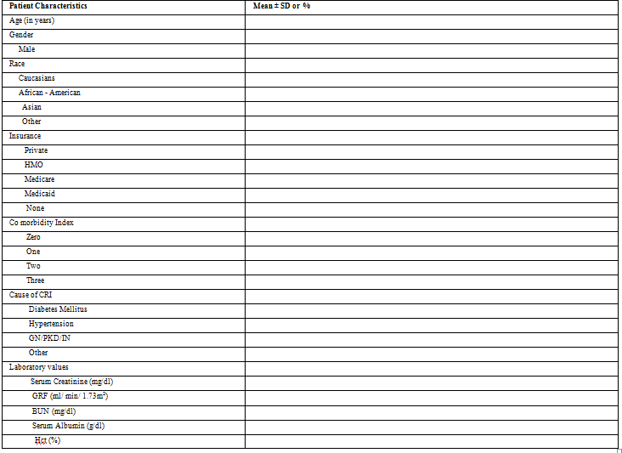
Baseline Characteristics of patients with Chronic Kidney Disease (CKD) – A hypothetical Table

Slide 147
Word of caution!!!
Please Note that there is no p-values column in the below table as no comparison is being made.

Slide 148
Comparison between two groups
If the comparison is to be made between two groups, then values on each variable in both groups must be calculated, with a p-value indicating any difference .

Slide 149
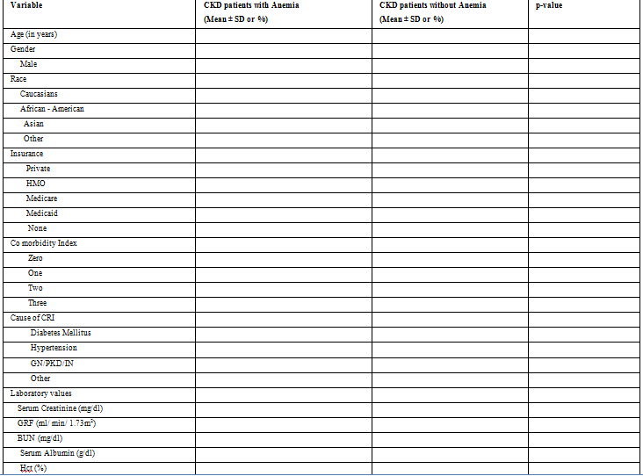
Comparison of Characteristics of Patients with and without Anaemia- A hypothetical table

Slide 150
Programs to be use for Data Analysis
Briefly describe the software packages that will be used.
Software Name
Version

Slide 151
Work Schedule or Timeline
A work schedule is a table that summarizes the tasks to be performed in the research project, the duration of each activity.

Slide 152
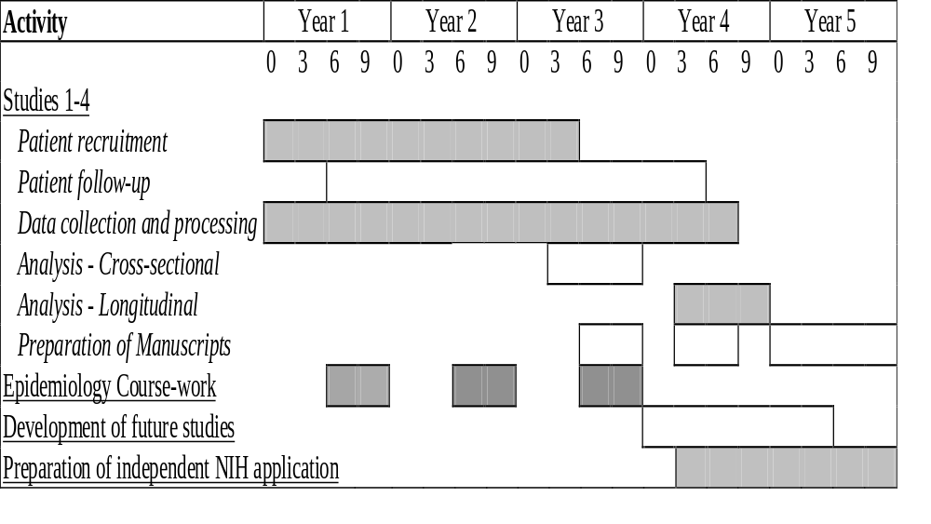
Work Schedule and Timeline for Researcher

Slide 153
Appendix
The appendix must include
CV of Researchers
CV of Supervisor
Previous Published Articles
Information on institutional affiliations of researchers
Sample of data collection instrument
Informed consent form
Letters for endorsement for the study

Slide 154
Logistics
A description of the resources and facilities available for the study
Any anticipated difficulty
A brief management plan
A realistic budget

Slide 155
References
What is Plagiarism?
What is Referencing?
What is citation?
What is the difference between References and Bibliography?

Slide 156
For an Article
Author(s)’ Surname followed by initials. Title of article. Name of Journal. Year, Volume, (number): page numbers of article.
Example:
Louria DB. Emerging- and re-emerging infections: The societal variables. International Journal of Infectious Disease. 1996, 1(2):59-62.

Slide 157
For a Book
Author(s)’ Surname followed by initials. Title of book. Place: Publisher, Year, Edition
Example:
Abramson JH. Survey methods in community medicine. Edinburgh: Churchill Livingstone, 1990, 4th ed.

Slide 158
For a Chapter in a Book
Author(s) of chapter (Surname(s) followed by initials). Chapter title. In: Editor(s) of book, (Surname(s) followed by initials). (eds). Title of book. Place: Publisher, Year: Page numbers of chapter.
Example:
Todd J and Barongo L. Epidemiological methods. In: Ng’weshemi J, Boerma T, Bennett J and Schapink D (eds). HIV prevention and AIDS care in Africa; A district level approach. Amsterdam: KIT Press, 1997: 51-68.

