Slide 1
Measurement Scale &
Basic Concepts of Bio-statistics

Slide 2
What is Measurement?
Measurement is the systematic process by which things are differentiated

Slide 3
Types of Measurement
There are two types of measurement scales:
Qualitative Scales
  The Nominal Scale
  The Ordinal Scale
Quantitative Scales
  An Interval Scale
  The Ratio Scale

Slide 4
Measurement Scale - Qualitative Scales
The Nominal Scale
The nominal scale provides classification without assigning any value to the categories
Names are assigned to different categories
For example:
  Cerebral palsy is categorized into diplegic, quadriplegic or hemiplegic
  Gender is categorized into male and female

Slide 5
Measurement Scale - Qualitative Scales
The Ordinal Scale
The ordinal scale ‘‘ranks or orders’’ the certain quality
Used for comparisons like ‘‘greater or less’’
Example of Order:
  Amount of assistance required to ambulate a patient is rated as minimal, moderate or maximal
  Cancer patients can be categorized into initial stage, moderate stage and advanced stage
Example of Rank:
  ???

Slide 6
Measurement Scale - Quantitative Scales
An Interval Scale
Contains information not only the relative order of the measurements as in the ordinal scale but also the size of the interval between measurements
Size of interval remains the same
Difference between measurement of 10 and a measurement of 20 is equal to the difference between measurements of 20 and 30
The Celsius and Fahrenheit scales are the examples

Slide 7
Measurement Scale - Quantitative Scales
The Ratio Scale
The ratio scale has an absolute zero point
Length, time and weight are normally considered ratio scale because their absence is scored as Zero
The interval is known to be equal e.g., 1 ton = 1016 Kg; and 2 tons = 2032 Kg therefore [1 : 2] = [1016 : 2032]
The ratio scale is appropriate for measuring crop yields, distances, weights, heights, income, length, time, mass, volume, etc.

Slide 8
Types of Variables with Respect to Measurement
Variables can be classified with respect to measurement into
Categorical Variable
Numerical Variable

Slide 9
Types of Variables with Respect to Measurement
Categorical Variable
A categorical variable is one for which the observations recorded result in a set of categories
There is a distinct demarcation between the categories
For example:
  Gender (male and female)
  Recovery from treatment (not recovered, partially recovered and completely recovered)
Categorical variables are often referred to as qualitative variables

Slide 10
Types of Variables with Respect to Measurement
Numerical Variable
A numerical variable is one for which the observations are recorded in numerical values such as, age, height, etc.
Numerical variable has further two types i.e., Discrete and Continuous
Numerical variable is often referred to as a quantitative variable

Slide 11
Types of Variables with Respect to Measurement
Numerical Variable
Discrete Variable
  A variable that is capable of taking a set of discrete numerical values such as 10, 15, 1, 199, etc., but not every possible value between two given numbers
  For example, The number of heart beats in a fixed time period, number of successful operations in a hospital; number of cases reported at a casualty

Slide 12
Types of Variables with Respect to Measurement
Numerical Variable
Continuous Variable
A variable, which is capable of taking every possible value between two given number is termed as a continuous variable.
Age, weight, length, etc. are a few examples of continuous variables

Slide 13
Frequency Distribution
Frequency Distribution
  Frequency distribution is the number of times each score is represented in a data set
  For example: 100, 100, 90, 95, 105, 95, 95

Slide 14
Frequency Distribution
Relative Frequency
Relative Frequency
  Relative frequency of a class interval is proportion of the class frequency in relation to the total frequencies
  The purpose of calculating the relative frequencies is to obtain the idea of proportion, and percentage
  There are about 27.5% students whose weight lies in the weight group 58.5 - 65.5 Kg

Slide 15
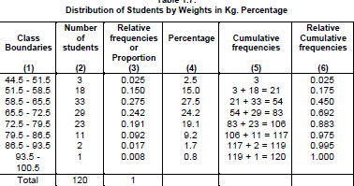
Frequency Distribution

Slide 16
Frequency Distribution
Cumulative Frequency
Cumulative Frequency
  The cumulative frequency is the total number of observations having values less than the upper limit of that class interval
  One of the advantages of the construction of cumulative frequency table is that, one gets immediate picture that how many students have weight less than or equal to a certain point
  For example there are 117 students whose weights are less than or equal to 86.5 Kg

Slide 17
Frequency Distribution
Frequency Curve
Frequency Curve
  A curve representing the frequency with which a variable assumes its value

Slide 18
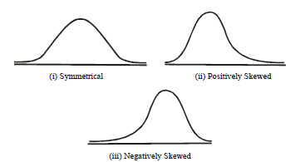
Frequency Distribution
Types of frequency curve

Slide 19
Measures of
Central Tendency
Central tendency is a characteristic of a data set that relates to its average value
It is the central value in the sense that it is located in the middle and the data points cluster around it
Central tendency measures are useful for the purpose of comparison of two or more similar types of data sets

Slide 20
Measures of
Central Tendency
Most commonly used measures are:
  Mean
  Mode
  Median

Slide 21
Measures of Central Tendency
Mean
  Arithmetic mean or most commonly Mean of a data set is the sum of the observations divided by the number of observations
  For example: 100+100+90+95+105+ 95+ 95=
  680/7 = 97

Slide 22
Measures of Central Tendency
Mean
Mean for grouped data
  In a grouped data, first we find the Midpoints of groups
  Midpoints are multiplied by the corresponding frequencies of those groups
  All these products are added

Slide 23
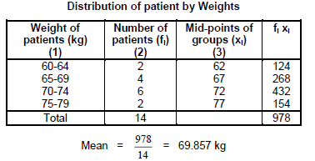
Measures of Central Tendency
Mean

Slide 24
Measures of Central Tendency
Mean
Mean is the most important measure of central tendency because it contains from all the scores in the distribution
On the hand, extreme values of data can distort the mean

Slide 25
Measures of Central Tendency
Median
Median
This is the middle most value of an arranged data
If the numbers of observation are odd, the middle value is the median
Median = 25
5 | 10 | 15 | 20 | 25 | 30 | 35 | 40 | 45

Slide 26
Measures of Central Tendency
Median
Median
If the numbers of observation are even,
Median = 25+30/2
= 27.5
5 | 10 | 15 | 20 | 25 | 30 | 35 | 40 | 45 | 50

Slide 27
Measures of Central Tendency
Median
Median is a useful measure of central tendency when data has extreme values that can distort Mean of data
On the other hand it has disadvantage that it does not contain information from all of the scores in a data set

Slide 28
Measures of Central Tendency
Mode
Mode
  Mode is the most frequently occurring number in the data set
  Mode = 60
55 | 60 | 65 | 60 | 45 | 75

Slide 29
Measures of Central Tendency
Mode
Mode
  Mode = 60+65+45+55/4
  = 56.25
55 | 60 | 65 | 60 | 45 | 75 | 45 | 55 | 65 | 60

Slide 30
Measure of Dispersion
Statistical measures of dispersion are used to measure the extent to which individual observations disperse or cluster around the average
Measures of Dispersion like Mean are also used to compare two or more data sets of same nature
Only two measures, which are commonly used in medical science, will be described
  Range and Standard Deviation

Slide 31
Measure of Dispersion
Range
  Range is the difference between maximum and minimum values of data set, such as blood pressure, blood cholesterol level, haemoglobin (Hg/dl) etc.
  It provides a quick value of variation in medical sciences
5 | 10 | 15 | 20 | 25 | 30 | 35 | 40 | 45 | 50

Slide 32
Measure of Dispersion
Variance
  How much the data points are spread around the mean
  We will find the difference between each data point and the mean, and average these differences
  The variance is a measure of variability around mean within a data set
  The variability score indicates how high or low a score is compared with the mean

Slide 33
Measure of Dispersion
Standard Deviation
  The most widely used and stable measure of dispersion is the standard deviation. This is a square root of variance
  A low standard deviation indicates that the data points tend to be very close to the mean (also called expected value)
  A high standard deviation indicates that the data points are spread out over a large range of values

Slide 34
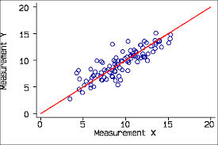
Measure of Dispersion

Slide 35


Measure of Dispersion
The computation of standard deviations for grouped data
The computation of standard deviations for ungrouped data

Slide 36
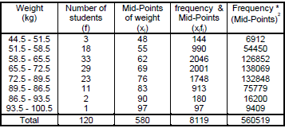
Measure of Dispersion

Slide 37
Relative Measure
Measures we have discussed are called absolute measures i.e., these are measured in terms of their basic units e.g. height, weight etc.
We have two same data sets but measured in different unit (weight in kilograms and pounds) and want to compare these data sets
It is not possible to make such comparison, as the basic units are different
Measures, which enable us to make such comparisons, are free of units and are called Relative Measures

Slide 38

Relative Measure
Coefficient of Variation
  Coefficient of variation (CV) is a relative measure of variation in any variable
  If the units of the two or more data sets are different then coefficient of variation is the best method for comparison

Slide 39
Relative Measure
Coefficient of Variation
Comparing two or more data sets, if one data set has less Coefficient of Variation is more consistent, more homogeneous and more stable than a data set that has larger C.V.

Slide 40
Relative Measure
Coefficient of Variation
Suppose the authors of the study on diet and lipoproteins want to compare the variability in the ratio of total/HDL cholesterol with the variability in vessel diameter change
The mean and the standard deviation of total/HDL cholesterol (in mill moles per litre) are 5.81 and 1.20 respectively
The mean and the standard deviation for the vessel diameter change (in millimetres), they are 0.12 and 0.29, respectively
A comparison of means or SDs makes no sense because cholesterol and vessel diameter are measured on different scales

Slide 41
Relative Measure
Coefficient of Variation
CV for HDL Cholesterol = (1.20/5.81) (100) = 20.7%
CV for vessel diameter change is (0.29/0.12) (100) = 241.7%
We can conclude that the relative variation in vessel diameter change is much greater than (more than 10 times as great as) that in cholesterol ratio

Slide 42
Correlation Coefficient
It is the degree of relationship exists between two or more variables
Relationships can be between:
  different variables like bone density and age OR
  repeated measures of the same variable (blood pressure of the same person measured by 4 different physicians )

Slide 43
Correlation Coefficient
  Its value lies between 0 to 1
  0 means no correlation
  1 means perfect correlation
  Values between the extremes are called intermediate correlation
  Its value can also be in negative
  A negative correlation shows an inverse correlation between the variables (value of one variable increases and other decreases)

Slide 44
THANK YOU!!!

