Slide 1
VARIABLES

Slide 2
VARIABLE
A variable is anything that can vary, i.e. changed or be changed, such as memory, attention, time taken to perform a task, etc.
Variable are given a special name that only applies to experimental.
One is called the dependent variable and the other the independent variable.
In an experiment, the researcher is looking for the possible effect on the dependent variable that might be caused by changing

Slide 3
Independent variable (IV)
Variable the experimenter manipulates (i.e. changes) – assumed to have a direct effect on the dependent variable.

Slide 4
Dependent variable (DV)
Variable the experimenter measures, after making changes to the IV that are assumed to affect the DV.

Slide 5
example
For example, we might change the type of information (e.g. organized or random) given to participants to see what effect this might have on the amount of information remembered.
In this particular example the type of information is the independent variable (because it changes) and the amount of information remembered is the dependent variable (because this is being measured).

Slide 6
Operationalising Variables

Slide 7
It is very important in research to clearly define what you mean by both your IV and DV.

Slide 8
Operational variables
Operational variables (or operationalizing definitions) refer to how you will define and measure a specific variable as it is used in your study.

Slide 9
example
if we are concerned with the effect of media violence on aggression, then we need to be very clear what we mean by the different terms. In this case, we must state what we mean by the terms “media violence” and “aggression” as we will study them.
Therefore, you could state that “media violence” is operationally defined (in your experiment) as ‘exposure to a 15 minute film showing scenes of physical assault’; “aggression” is operationally defined as ‘levels of electrical shocks administered to a second ‘participant’ in another room’.

Slide 10
example
In another example, the hypothesis “Young participants will have significantly better memories than older participants” is not operationalized. How do we define "young", “old” or "memory"? "Participants aged between 16 - 30 will recall significantly more nouns from a list if twenty than participants aged between 55 - 70" is operationalized.

Slide 11
The key point here is that we have made it absolutely clear what we mean by the terms as they were studied and measured in our experiment.
If we didn’t do this then it would be very difficult (if not impossible) to compare the findings of different studies into the same behavior.

Slide 12
Operationalization has the great advantage that it generally provides a clear and objective definition of even complex variables. It also makes it easier for other researchers to replicate a study and check for reliability.

Slide 13
Extraneous Variables
When we conduct experiments there are other variables that can affect our results, if we do not control them. The researcher wants to make sure that it is the manipulation of the independent variable that has changed the changes in the dependent variable.
Hence, all the other variables that could affect the DV to change must be controlled. These other variables are called extraneous or confounding variables.

Slide 14
Extraneous Variables
These are all variables, which are not the independent variable, but could affect the results (e.g. dependent variable) of the experiment.
Extraneous variables should be controlled were possible. They might be important enough to provide alternative explanations for the effects.

Slide 15
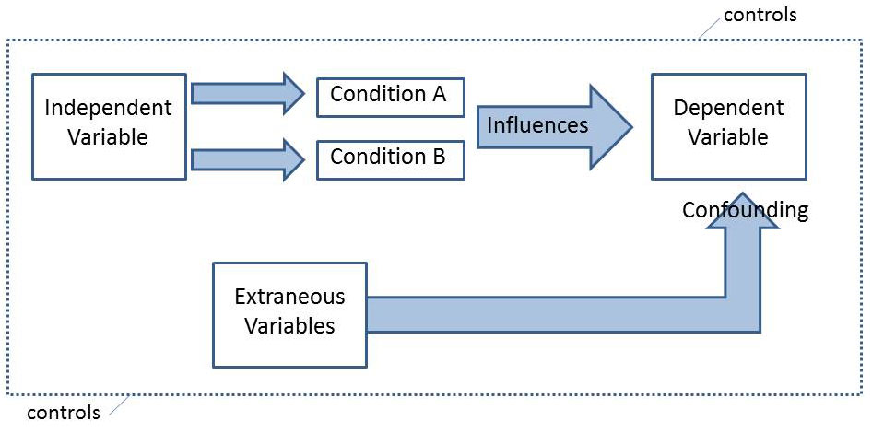

Slide 16
four types of extraneous variables

Slide 17
1. Situational Variables
These are aspects of the environment that might affect the participant’s behavior, e.g. noise, temperature, lighting conditions, etc. Situational variables should be controlled so they are the same for all participants.
Standardized procedures are used to ensure that conditions are the same for all participants. This includes the use of standardized instructions

Slide 18
2. Participant / Person Variable
This refers to the ways in which each participant varies from the other, and how this could affect the results e.g. mood, intelligence, anxiety, nerves, concentration etc.

Slide 19
Example
For example, if a participant that has performed a memory test was tired, or had poor eyesight, this could effect their performance and the results of the experiment. The experimental design chosen can have an affect on participant variables.

Slide 20
Participant / Person Variable
Situational variables also include order effects that can be controlled using counterbalancing, such as giving half the participants condition 'A' first, while the other half get condition 'B' first. This prevents improvement due to practice, or poorer performance due to boredom.
Participant variables can be controlled using random allocation to the conditions of the independent variable.

Slide 21
3. Experimenter / Investigator Effects
The experimenter unconsciously conveys to participants how they should behave - this is called experimenter bias.
The experiment might do this by giving unintentional clues to the participants about what the experiment is about and how they expect them to behave. This affects the participants’ behavior.

Slide 22
Experimenter / Investigator Effects
The experimenter is often totally unaware of the influence which s/he is exerting and the cues may be very subtle but they may have an influence nevertheless.
Also, the personal attributes (e.g. age, gender, accent, manner etc.) of the experiment can affect the behavior of the participants.

Slide 23
4. Demand Characteristics
these are all the clues in an experiment which convey to the participant the purpose of the research.
Participants will be affected by: (i) their surroundings; (ii) the researcher’s characteristics; (iii) the researcher’s behavior (e.g. non-verbal communication), and (iv) their interpretation of what is going on in the situation.

Slide 24
Demand Characteristics
Experimenters should attempt to minimize these factors by keeping the environment as natural as possible, carefully following standardized procedures. Finally, perhaps different experimenters should be used to see if they obtain similar results.

Slide 25
EXAMPLE
Suppose I wanted to measure the effects of Alcohol (IV) on driving ability (DV) I would have to try to ensure that extraneous variables did not affect the results. These variables could include:

Slide 26
Familiarity with the car: Some people may drive better because they have driven this make of car before.
• Familiarity with the test: Some people may do better than others because they know what to expect on the test.
• Used to drinking. The effects of alcohol on some people may be less than on others because they are used to drinking.
• Full stomach. The effect of alcohol on some subjects may be less than on others because they have just had a big meal.

Slide 27
If these extraneous variables are not controlled they may become confounding variables, because they could go on to affect the results of the experiment.

