Slide 1

Sampling Procedures & Sample Size Estimation

Slide 2
Sampling
Sampling is procedure or process of selecting some units from the population with some common characteristics
It is primarily concerned with the collection of data of some selected units of the population

Slide 3
Sampling
Census
  another method of data collection and is defined as a complete enumeration of the population
Sampling frame
  a list of population units from which the sample is selected

Slide 4
Sampling
Sampling Error
Sample is a part of population, the results based on the sampled observations will not be equal to that of population results
There must be some differences which are inevitable
Sampling Error
  Differences between observed values and the total population
  e.g., prevalence of TB in a sample cannot be identical to its prevalence in population

Slide 5
Sampling
Sampling Error
Sampling error decreases as the sample size increases
The sampling error is reduced to minimum if
  the choice of the sampling unit
  sampling design
  selection procedure
  sample size
  method of data analysis are appropriate

Slide 6
Sampling
Non-Sampling Error
Error arising from the causes which are not associated with the sampling process is known as non-sampling error
Commonly found in both, complete enumeration and sample surveys
Non-sampling error includes:
  response error
  non-response error
  measurement and coding error
  improper method for statistical analysis
  non-coverage of population
  interviewers error
  data entry error

Slide 7
Sampling
Non-Sampling Error
In general, if the sample is proper representative of a population, sampling error is minimum

Slide 8
Sampling
Advantages
A sample is a part of population; the information can be collected more cheaply and more rapidly as compared to complete enumeration
A sample makes it possible to concentrate on individual units and to obtain relevant information comprehensively and accurately.
Selection of appropriate sampling design reduces non-sampling error
More precise results can be obtained

Slide 9
Sampling
Characteristics of Sampling Design
Sample design must result in a truly representative sample
Sample design must be such which results in a small sampling error
Sample design must be viable in the context of funds available for the research study
Sample design must be such so that systematic bias can be controlled in a better way
Sample should be such that the results of the sample study can be applied, in general, for the universe with a reasonable level of confidence

Slide 10
Types of Samples
Probability (Random) Samples
  Simple random sample
  Systematic random sample
  Stratified random sample
  Multistage sample
  Cluster sample
Non-Probability Samples
  Convenience sample
  Purposive sample
  Quota
Notes:
Two general approaches to sampling are used in social science research. With probability sampling, all elements (e.g., persons, households) in the population have some opportunity of being included in the sample, and the mathematical probability that any one of them will be selected can be calculated. With nonprobability sampling, in contrast, population elements are selected on the basis of their availability (e.g., because they volunteered) or because of the researcher's personal judgment that they are representative. The consequence is that an unknown portion of the population is excluded (e.g., those who did not volunteer). One of the most common types of nonprobability sample is called a convenience sample – not because such samples are necessarily easy to recruit, but because the researcher uses whatever individuals are available rather than selecting from the entire population.
Because some members of the population have no chance of being sampled, the extent to which a convenience sample – regardless of its size – actually represents the entire population cannot be known

Slide 11
Probability Sampling
A probability sampling scheme is one in which every unit in the population has a chance (greater than zero) of being selected in the sample

Slide 12
Probability Sampling
Probability sampling includes:
  Simple Random Sampling
  Systematic Sampling
  Stratified Random Sampling
  Cluster Sampling

Slide 13
Non-Probability Sampling
Any sampling method where some elements of population have no chance of selection (these are sometimes referred to as 'out of coverage‘ /‘ under covered'), or where the probability of selection can't be accurately determined.
Participants’ selection is according to specific criteria

Slide 14
Non-Probability Sampling
Example: We visit every household in a given street, and interview the first person to answer the door
In any household with more than one occupant, this is a nonprobability sample, because some people are more likely to answer the door (e.g. an unemployed person who spends most of their time at home is more likely to answer than an employed housemate who might be at work when the interviewer calls) and it's not practical to calculate these probabilities

Slide 15
Non-probability Sampling
Nonprobability Sampling includes:
  Convenience Sampling
  Quota Sampling
  Purposive Sampling

Slide 16
Simple Random Sampling
Applicable when population is small, homogeneous & readily available
All subsets of the frame are given an equal probability to be selected
It provides for greatest number of possible samples
This is done by assigning a number to each unit in the sampling frame

Slide 17
Simple Random Sampling
Advantages
  Simple random sampling selection procedure is very simple and easily understandable as each unit of population has an equal chance to be in the sample and also each selected sample has an equal probability
  This design is ineffective if the population units are highly variable

Slide 18
Replacement of Selected Units
Sampling schemes may be without replacement ('WOR' - no element can be selected more than once in the same sample) or with replacement ('WR' - an element may appear multiple times in the one sample).
For example, if we catch fish, measure them, and immediately return them to the water before continuing with the sample, this is a WR design, because we might end up catching and measuring the same fish more than once. However, if we do not return the fish to the water (e.g. if we eat the fish), this becomes a WOR design

Slide 19
Systematic Sampling
In systematic selection procedure, only the first unit is selected at random and the rest of the units are automatically determined
Systematic sampling involves a random start and then proceeds with the selection of every kth element from then onwards. In this case, k=(population size/sample size)
It is important that the starting point is not automatically the first in the list, but is instead randomly chosen

Slide 20

Systematic Sampling

Slide 21
Systematic Sampling
This type of selection procedure is very useful when the population size is unknown or sampling frame is not possible
If the population size is known, it is advisable to use simple random sampling selection procedure
Selection is simple, easier and quicker
It involves less cost as compared to simple random sampling

Slide 22
Stratified Sampling
If there is a large variation among the population units, then simple random sampling selection procedure will be less precise
If relatively more precise results are to be obtained, then the population is to be divided into different homogeneous groups, called strata
Stratification is a process of dividing the population into different strata and selecting a sample of the required number of units within strata, using the simple random sampling

Slide 23
Stratified Sampling
There are number of reasons for using this type of selection procedure:
  it may increase precision by reducing the variation
  it is easy to control the execution of survey
Stratification can be done by age, gender, race, area, nationality, type of patients admitted in the hospital, etc.

Slide 24
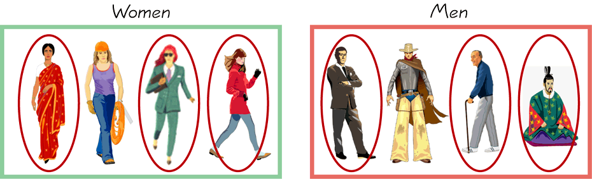
Stratified Sampling
        Draw a sample from each stratum

Slide 25
Cluster Sampling
Cluster sampling is a selection procedure in which population units (elements) are divided into convenient number of groups, called clusters
Each cluster contains some elements
A random sample of some clusters is selected using a simple random sampling procedure
Sampling units are groups rather than individuals
The concept of cluster was developed for the cases, where the list of elements is not available
For example, in a population survey, list of households is available whereas a list of persons is not

Slide 26
Cluster Sampling
Since cluster sampling consists of groups of elements, approach to the elements is faster, easier and more convenient than other sampling procedures
Cost will be less if the elements are grouped in a cluster rather than randomly dispersed throughout the area
Since cluster sampling is not a true representative sampling method as compared to simple random method, therefore, the efficiency will be less

Slide 27
Cluster Sampling
Suppose we would like to hold a TB survey in Dammam City and the list of households and list of persons are not known to us
We can divide the whole city into different sectors (clusters) say (40)
We try to divide the population into equal size clusters as far as possible
Suppose 10 sectors (clusters) are likely to be selected
We will use simple random sampling procedure to select 10 clusters
Then all the 10 selected clusters will be examined fully to check the prevalence of TB

Slide 28
Quota Sampling
First identify the stratums and their proportions as they are represented in the population
The number of interviews could be determined based on the proportion a given characteristic represents in the population
Then convenience or judgment sampling is used to select the required number of subjects from each stratum
For example, an interviewer may be told to sample 200 females and 300 males between the age of 45 and 60

Slide 29
Convenience Sampling
Sometimes known as grab or opportunity sampling or accidental or haphazard sampling.
A type of nonprobability sampling which involves the sample being drawn from that part of the population which is close to hand. That is, readily available and convenient.
The researcher using such a sample cannot scientifically make generalizations about the total population from this sample because it would not be representative enough

Slide 30
Convenience Sampling
For example, if the interviewer wants to know the experiences of football spectators after a match, he will stand outside a stadium and give questionnaire to the spectators after the match
This type of sampling is most useful for pilot testing
In social science research, snowball sampling is a similar technique, where existing study subjects are used to recruit more subjects into the sample

Slide 31
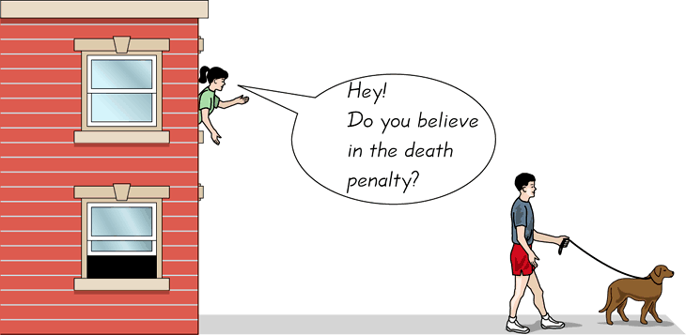
Convenience Sampling
  Use results that are easy to get
Notes:
31

Slide 32
Judgmental or Purposive Sampling
The researcher chooses the sample based on who they think would be appropriate for the study
This is used primarily when there is a limited number of people that have expertise in the area being researched

Slide 33
THANK YOU!!!

