Slide 1


Slide 2

WHAT IS RESEARCH?
Dr. Zahid Mehmood PT
Assistant Professor/ Researcher
MSPT-NMPT(RIU), DPT(IIRS), Certified Chiropractor

Slide 3
A Process of Systematic,
Scientific Data
RESEARCH is
Collection
Analysis &
Interpretation
So as to find Solutions to
a problem.

Slide 4
“Great scholars do not solve problems; they create them”
Albert Einstein

Slide 5
Types of Research
Qualitative
Quantitative

Slide 6
Types of Research
Qualitative
Qualitative research gathers non-numerical data to understand concepts, opinions, or experiences.
Example: Interviews, Focus Groups

Slide 7
Types of Research
Quantitative
Quantitative research collects numerical data to identify patterns and test hypotheses
Example: Surveys, Experiments

Slide 8
STEPS IN DESIGNING AND
CONDUCTING RESEARCH
Thinking about topic formulating research question/ objective
Matching the Research Design to research objectives
Defining and clarifying the research Variables/ Analysis plan
Drawing the Sample
Developing the tools & defining the methods of data collection
Monitoring and Carrying out the research
Preparing the Data for Analysis
Analyzing Data
Writing the Research Report

Slide 9
Research Risk
Physical risk: Potential harm or discomfort to a participant's body due to research procedures
Psychological risk: Potential emotional or mental distress caused by research activities
Social risk: Potential harm to a participant's social standing, relationships, or privacy due to the research
Economic risk: Potential financial loss or burden resulting from participation in research

Slide 10
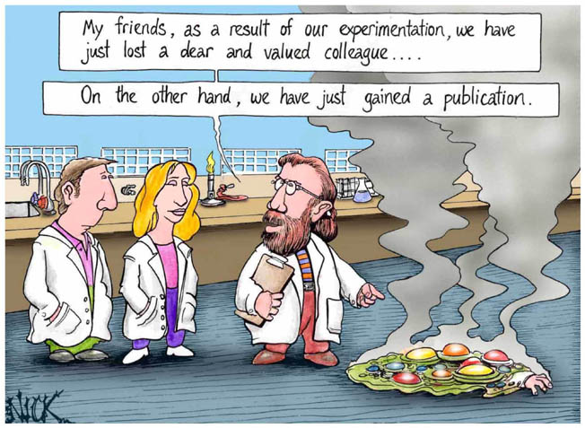

Slide 11


It is better to step forward and light a candle than to sit back and curse the darkness.

Slide 12



Slide 13
SELECTING A RESEARCH TOPIC

Slide 14
Literature Search:
What?
Allows one to search in a purposeful and systematic manner, through a range of literature or information relevant to ones particular field, and to hone in on material relevant to ones interest and objectives.

Slide 15
A Literature Search
Why?
To keep up with the latest developments in your field.
To learn more about some topic.
To document important facts and ideas you wish to research in light of previous work done on it.
To understand your data in the context of what is already known.
To provide your readers with sources they can consult on their own.

Slide 16
Means of Literature Search
INTERNET
Access to a massive pool of information related to biomedical and clinical source.
Can link with library catalogues, online databases, like MEDLINE and direct access to ever increasing number of biomedical journals.
Retrieval of data from a range of organizations universities, research establishments and hospitals.
Many services are available free of charge.

Slide 17
Search Strategy on Internet
Summarize your topic in one or two sentences.
Identify the unique ideas or concept associated with your topic.
Choose appropriate keywords for each concept.
Establish the relationship between each keyword and concept.

Slide 18
Example Pub Med Sources
PubMed is derived from two words, Publications, and Medical.
It is a project of the National Institute of Health, National Library of Medicine.
Available on the internet, as of 02 June 1999, there were 372 journals on this list.
It searches for you from about 9,000,000 papers.
For more details of PubMed, you may visit.
http://www.ncbi.nlm.nih.gov/PubMed/

Slide 19
Literature Search Resources
www.pubmed.org
www.pakmident.com
www.cochrane.org
www.cebm.net

Slide 20
Research
Objective

Slide 21
Research Objectives
An objective is an intent of what the researcher wants to do stated in clear measurable terms.”

Slide 22
Characteristics of Research Objective

Slide 23

S-M-A-R-T
Specific
Measurable
Achievable
Realistic
Time specific

Slide 24
Importance of Research
Objectives
Brings focus to the study.
Avoids collection of unnecessary data.
Determines an appropriate study design.
Helps determine analysis plan.

Slide 25

A Good Objective ensures that:
What is to be measured is clearly stated, be it a measure of frequency, or Association in the
population of interest.

Slide 26
Examples
Objectives:
1)To determine the effectiveness of keigel exercises during postnatal care in women visiting Tertiary care facilities of IIMC.
2) Comparing the effectiveness of lumbar stabilization exercises with general spinal exercises in patients with postero-lateral disc herniation.
3) To compare the effectiveness of dressing A vs. dressing B in patients presenting with infected wounds of the foot.

Slide 27
Objectives Start with:
To
Determine, find, identify, evaluate, estimate, assess, verify, elucidate, calculate, validate, etc

Slide 28
Operational Definition

Slide 29
Operational Definitions
Is the definition of the exposure and outcome variables of interest in context to objective in a particular study and their means of measurement/determination.
Examples:
  Effectiveness
  Comparison (basis of it)
  Wound healing

Slide 30
Operational Definition
Should clearly define and indicate means of measurement / determination of all exposure / outcome (dependent & independent ) variables indicated in the objectives.

Slide 31
Operational Definition
Research Objective:
To determine the effectiveness of a new physical therapy regimen in reducing lower back pain among adults.
Operational Definition:
Lower Back Pain:
  Definition: Pain localized between the lower ribcage and the buttocks.
  Measurement:
    Scale: Assessed using the Visual Analogue Scale (VAS) ranging from 0 (no pain) to 10 (worst possible pain).
    Frequency: Measured at baseline, and at 4-week and 8-week intervals during the study.
Effectiveness:
  Definition: Reduction in the intensity of lower back pain and improvement in functional mobility.
  Measurement:
    Pain Reduction: A decrease in VAS scores by at least 3 points from baseline to 8 weeks.
    Functional Mobility: Improvement measured by the Oswestry Disability Index (ODI), with a score reduction of at least 10 percentage points from baseline to 8 weeks.
Physical Therapy Regimen:
  Definition: A specific set of physical therapy exercises designed to strengthen the lower back muscles and improve flexibility.
  Measurement:
    Components: Exercises include stretching, strengthening, and aerobic activities.
    Frequency: Participants attend sessions three times a week for 8 weeks.
    Duration: Each session lasts 60 minutes, including a 10-minute warm-up, 40 minutes of targeted exercises, and a 10-minute cool-down period.

Slide 32
Thank You!!!

